Slide 1
BANKING SYSTEM
BY
PRIYA PREMPRAKASH BABU
CO19347 CSE 1ST YEAR

Slide 2
INTRODUCTION
The project covers few features of banking which are:
Opening an ordinary bank account.
ATM Machine working features.
Passbook printing.
Using these sets of code you can open a bank account which will be able to store all your personal data the is required to open a bank account eg. Name, Parent’s name, Address etc. Also you will be able to do some of the operations you usually do in an ATM like cash withdrawal, PIN change etc. also with every transaction the information of the transaction will be printed in the passbook eg. Time, date, balance etc. And at the end you will also be able to print the passbook.

Slide 3
WORKING
The program starts with asking your choice weather you want to create an account or you have an account. If you choose that you want to create an account it will go this way:
It will first ask for your personal details that are necessary for opening an account. It will ask you to create a PIN that will be used by used to carry out various operation for your account.
Then it will ask you to confirm the PIN, and if it doesn’t match the original password it show you an error and ask you to try again.
After all of the data is collected it will be stored in a file with your account no. eg. accountno.txt

Slide 4
WORKING
After all this it will also create a file will act as passbook for which you will be able to print any time, and it will be named like “accountno_passbook.txt”.
And this is how your account will be created, and at the end it will also ask if you want to create another account. If you enter ‘yes’ it will follow the same process, else it will end the program.

Slide 5
WORKING
And, if you choose “I have an account” then these are the process that will take place: 1. It will ask you to enter your name and account no., it will then open your account and copy your data to perform various process. 2. It will give you various options which are:
Cash withdrawal
Cash deposit
Pin change
Check balance
Update your personal details
Print passbook

Slide 6
OPTIONS
Here you will choose your options and the process will go accordingly.
Cash Withdrawal: It will ask you for your pin and check it if is correct it will ask you how much cash you want to withdrawal (YOU WILL HAVEONLY THREE ATTEMPTS ELSE IT WILL TERMINATE) and after finishing the transaction it will print your transaction in your passbook.
Cash Deposit: Here it will only ask you for your deposit amount and deposit it in your account and will enter your transaction into your passbook.
Pin Change: You will be asked to enter your old PIN (YOU WILL HAVE ONLY THREE ATTEMPTS) and if it is correct you will be asked to create a new PIN and to confirm it afterwards. And at last this action will also be printed in the passbook.
Check Balance: You will be shown your balance once you have correctly entered the PIN. Here, also this action will be printed in the passbook.

Slide 7
OPTIONS
Update Your Personal Details: In case you have entered your details wrong or want to update it you can try it here, you just have to correctly enter the PIN and all will be done. Similarly, this will also be printed.
Print Passbook: You can print your passbook once you have entered your PIN correctly here you will have only one attempt.

Slide 8
VARIOUS CLASSES AND FUNCTION BEING USED
1. dob: This class is used to store the date of birth of the account holder, which is the inherited to the main class. The member function that isused to get the date of birth is “get_dob” and a “print” function that is used to print the date of birth.
2. account: This is the main class the is responsible for the whole program to function. There various member functions of the class are:
display: This function displays the balance in the account.
get_data: This function gets the whole data of the account holder when the account is being created.
withdrawal: This function is used to withdrawal money from the account.
deposit: This function is used to deposit the money in the account.

Slide 9
VARIOUS CLASSES AND FUNCTION BEING USED
update: This function is used to update personal data of the account holder with may be entered incorrectly or need to be updated.
pin_change: This function is used to change the PIN of the account which is used to carry out various operation for the account.

Slide 10
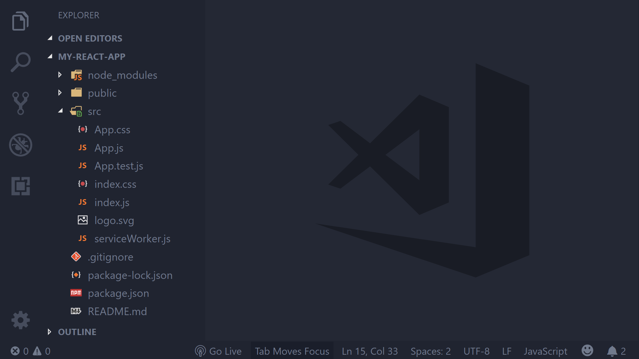

APPLICATIONS USED FOR APP DEVELOPMENT
VARIOUS APPLICATION USED TO DEVELOP THIS PROJECT:
VISUAL STUDIO CODE

